Slide 1

CommUnity
Seamless Community Interaction and Management

Slide 2

Problem Statement
Managing housing societies can be complex and inefficient, with challenges in communication, activity coordination, financial transparency, and security. Residents and administrators often face difficulties in staying connected, resolving issues, and managing daily operations effectively.

Slide 3

What is CommUnity ?
Modular, multi-tenant community management system
Simplifies housing society management
Enhances communication and engagement
Provides tools for admins and residents

Slide 4

What Does CommUnity Do?
CommUnity simplifies housing society management by providing a user-friendly platform for seamless communication providing these services:
Resident Management
Event Management
Complaint Handling

Slide 5
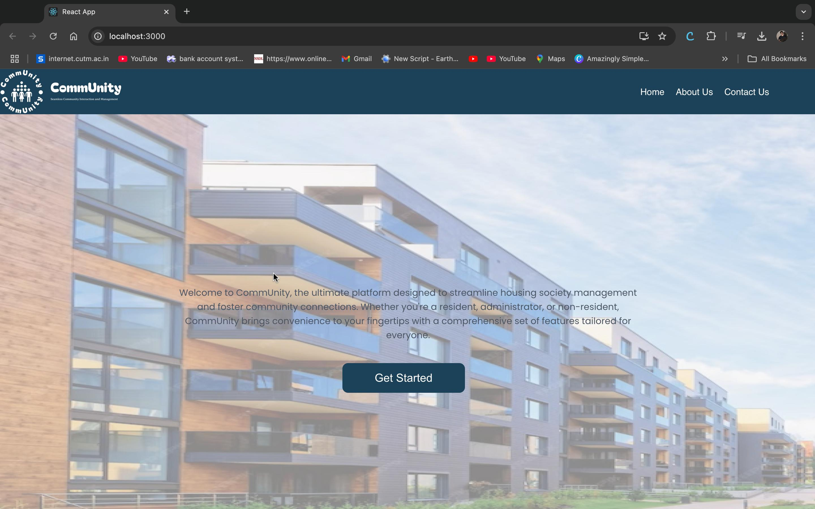
Screenshots of Key Modules

Slide 6
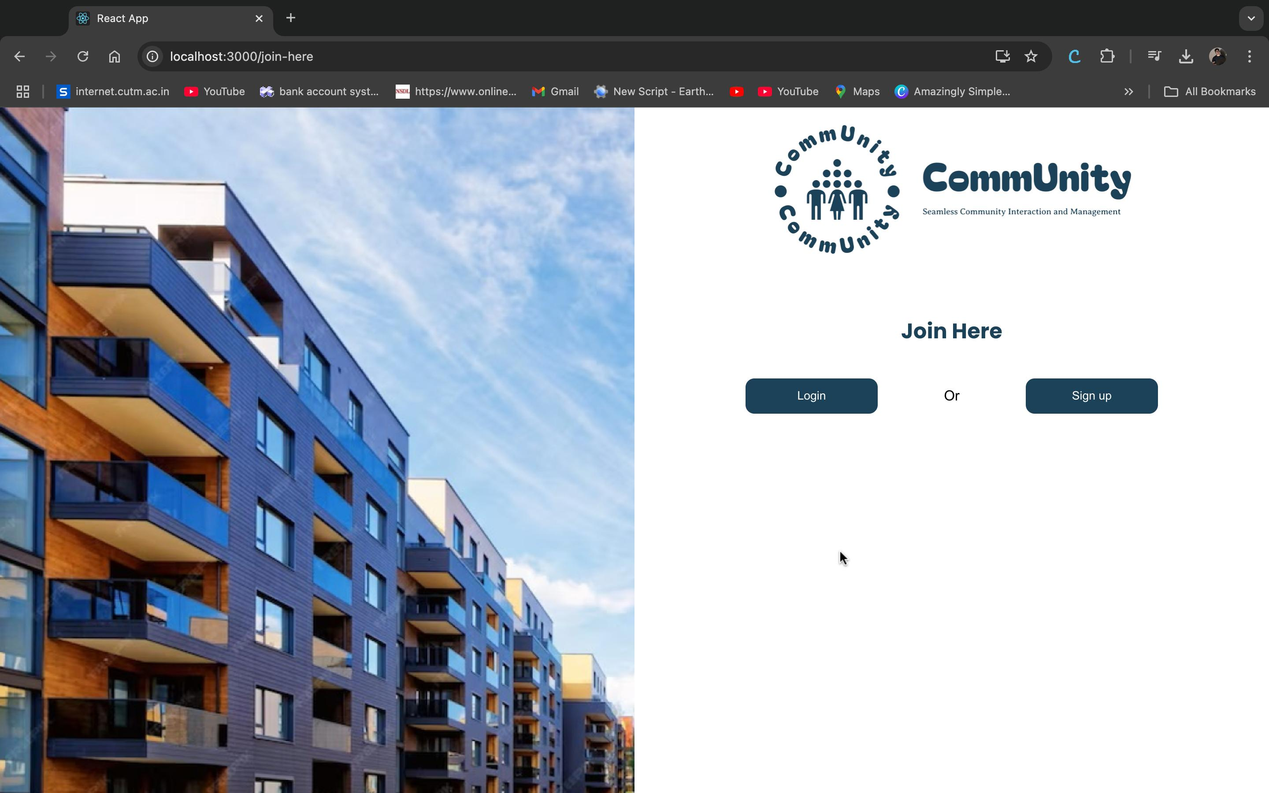

Slide 7
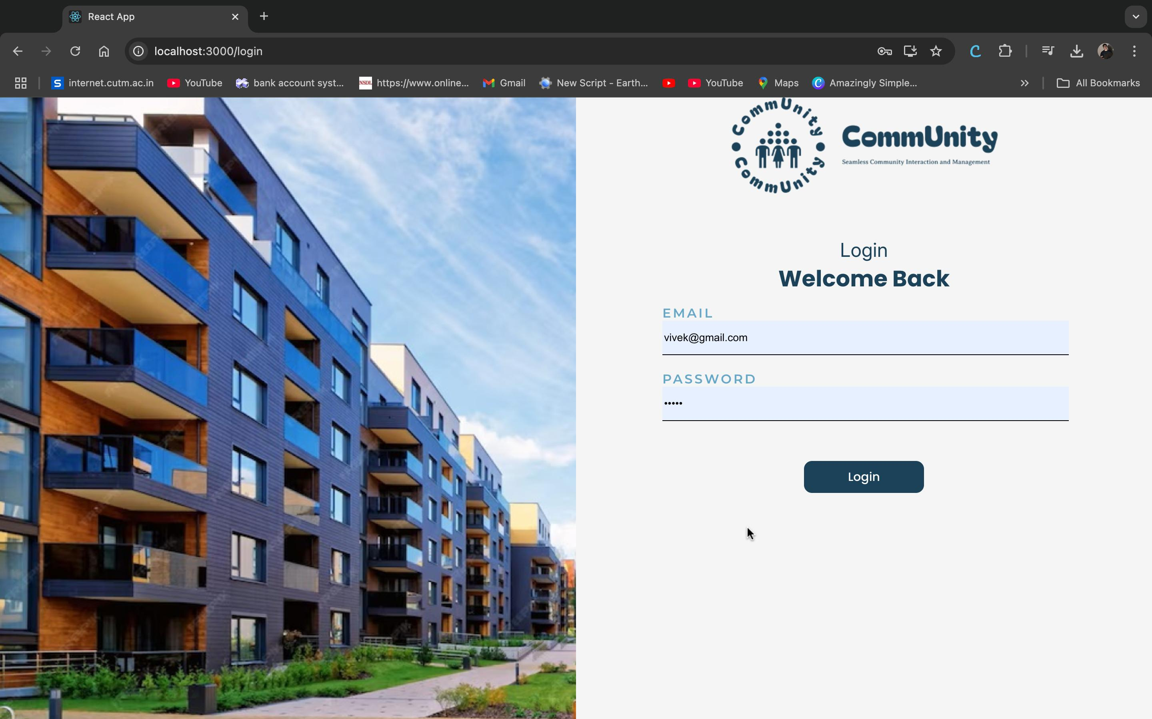

Slide 8
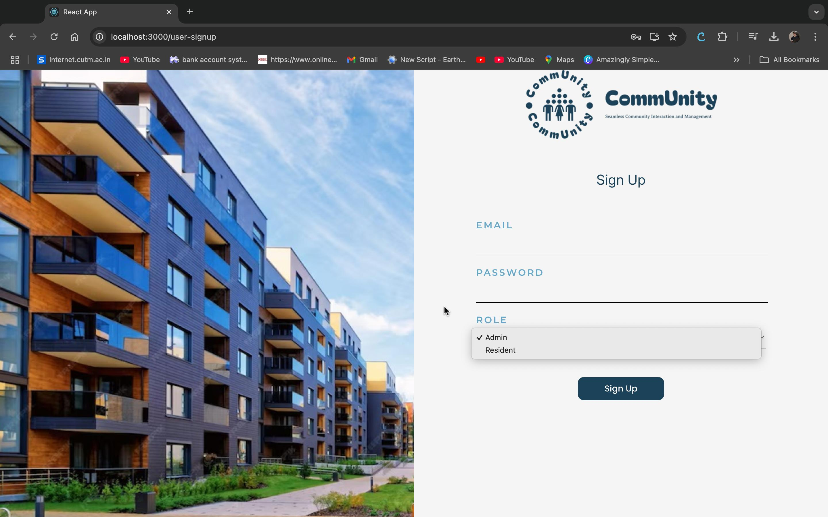

Slide 9
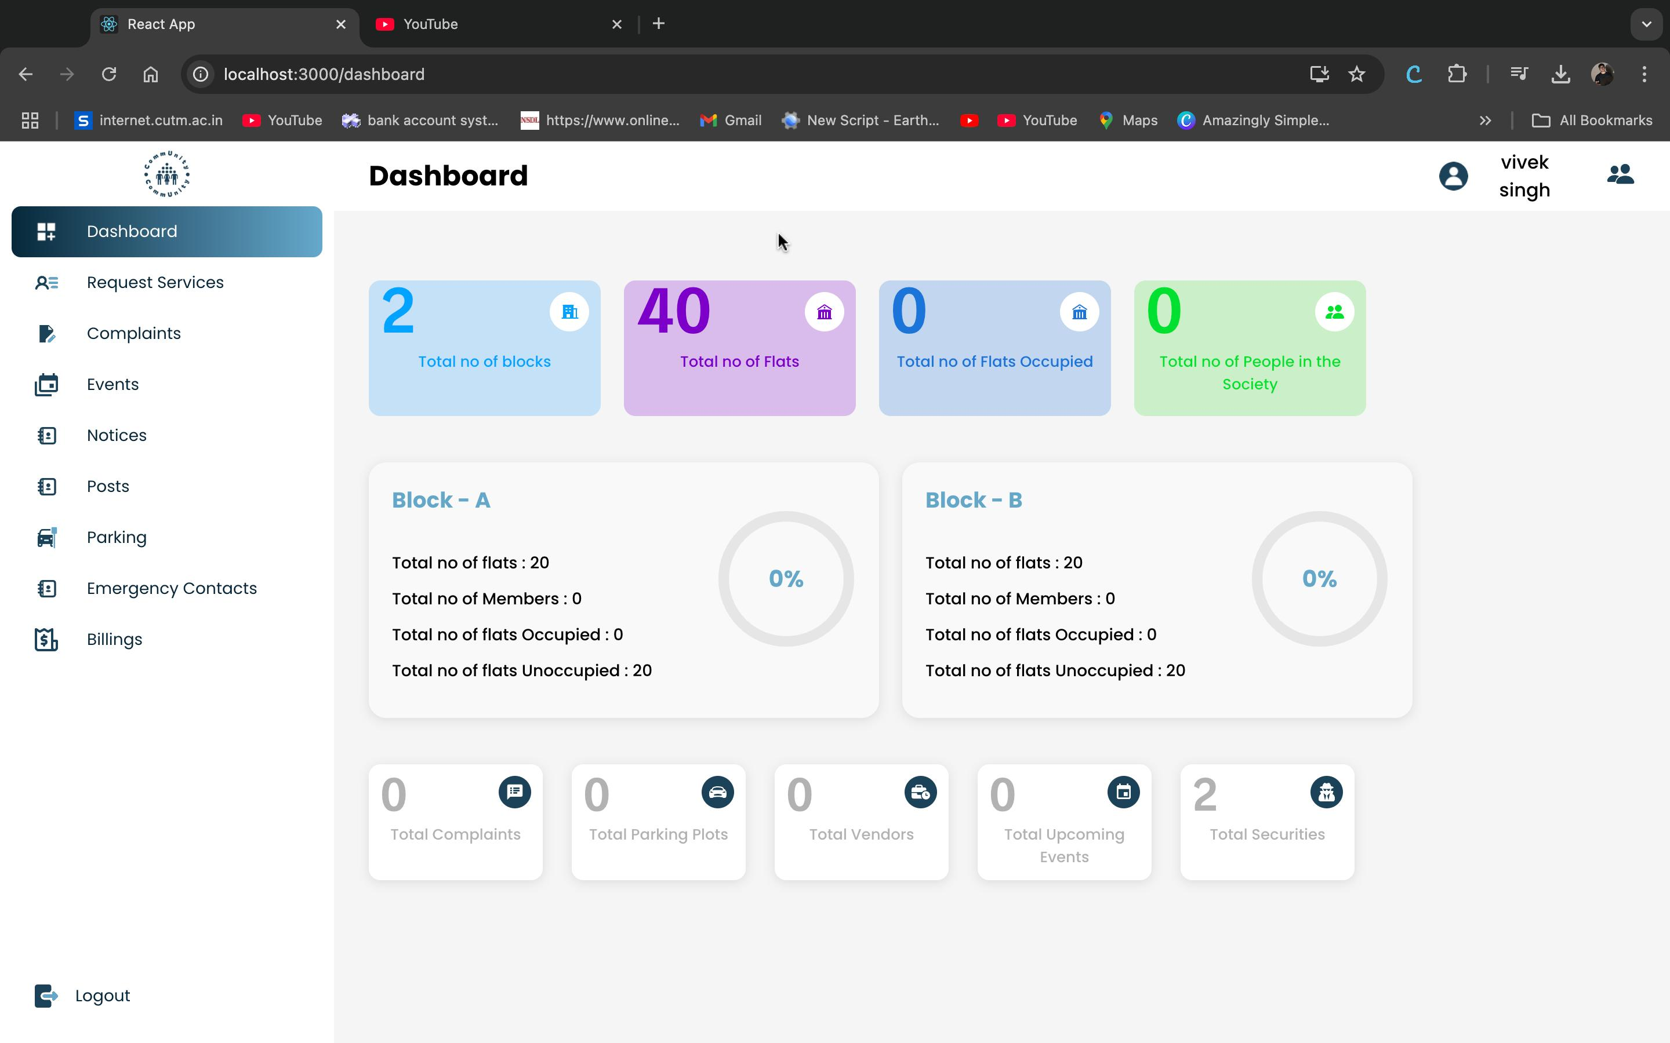

Slide 10
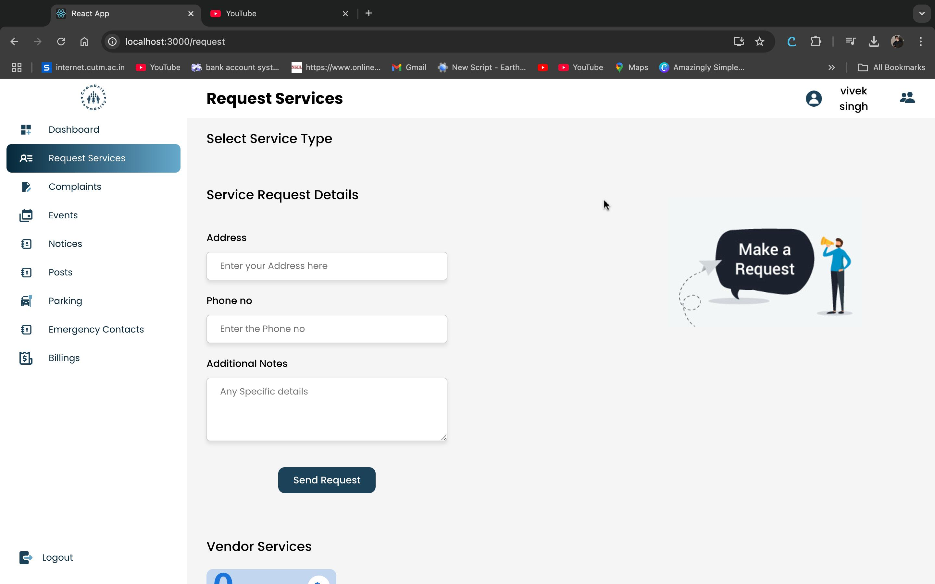

Slide 11
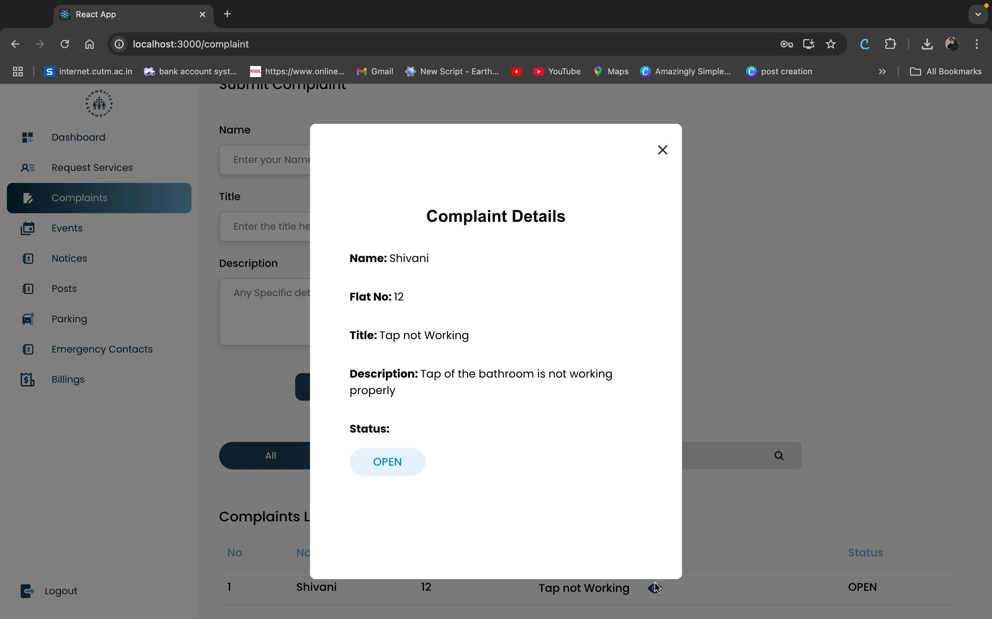
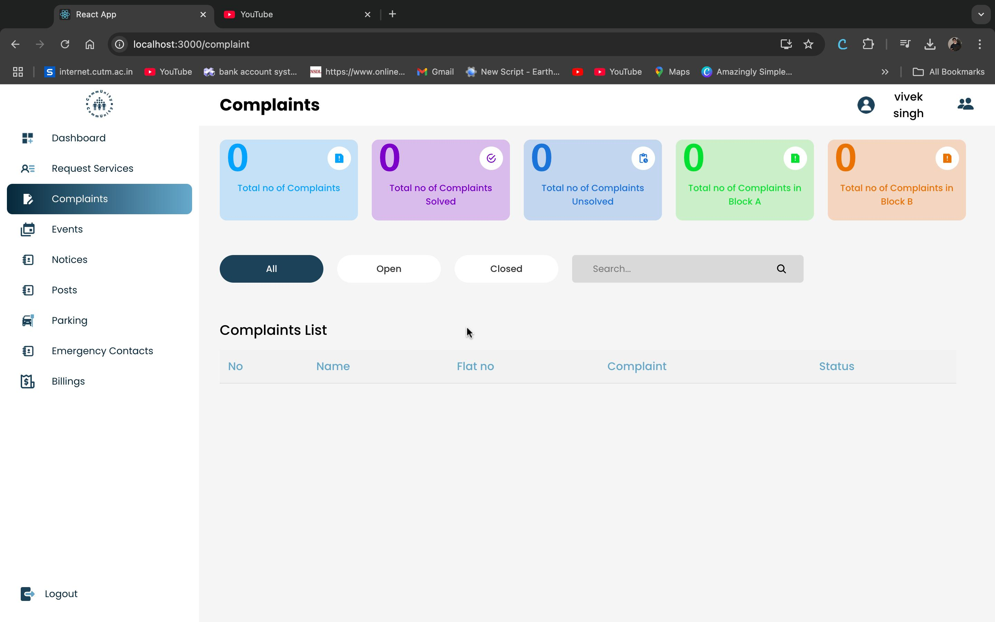

Slide 12
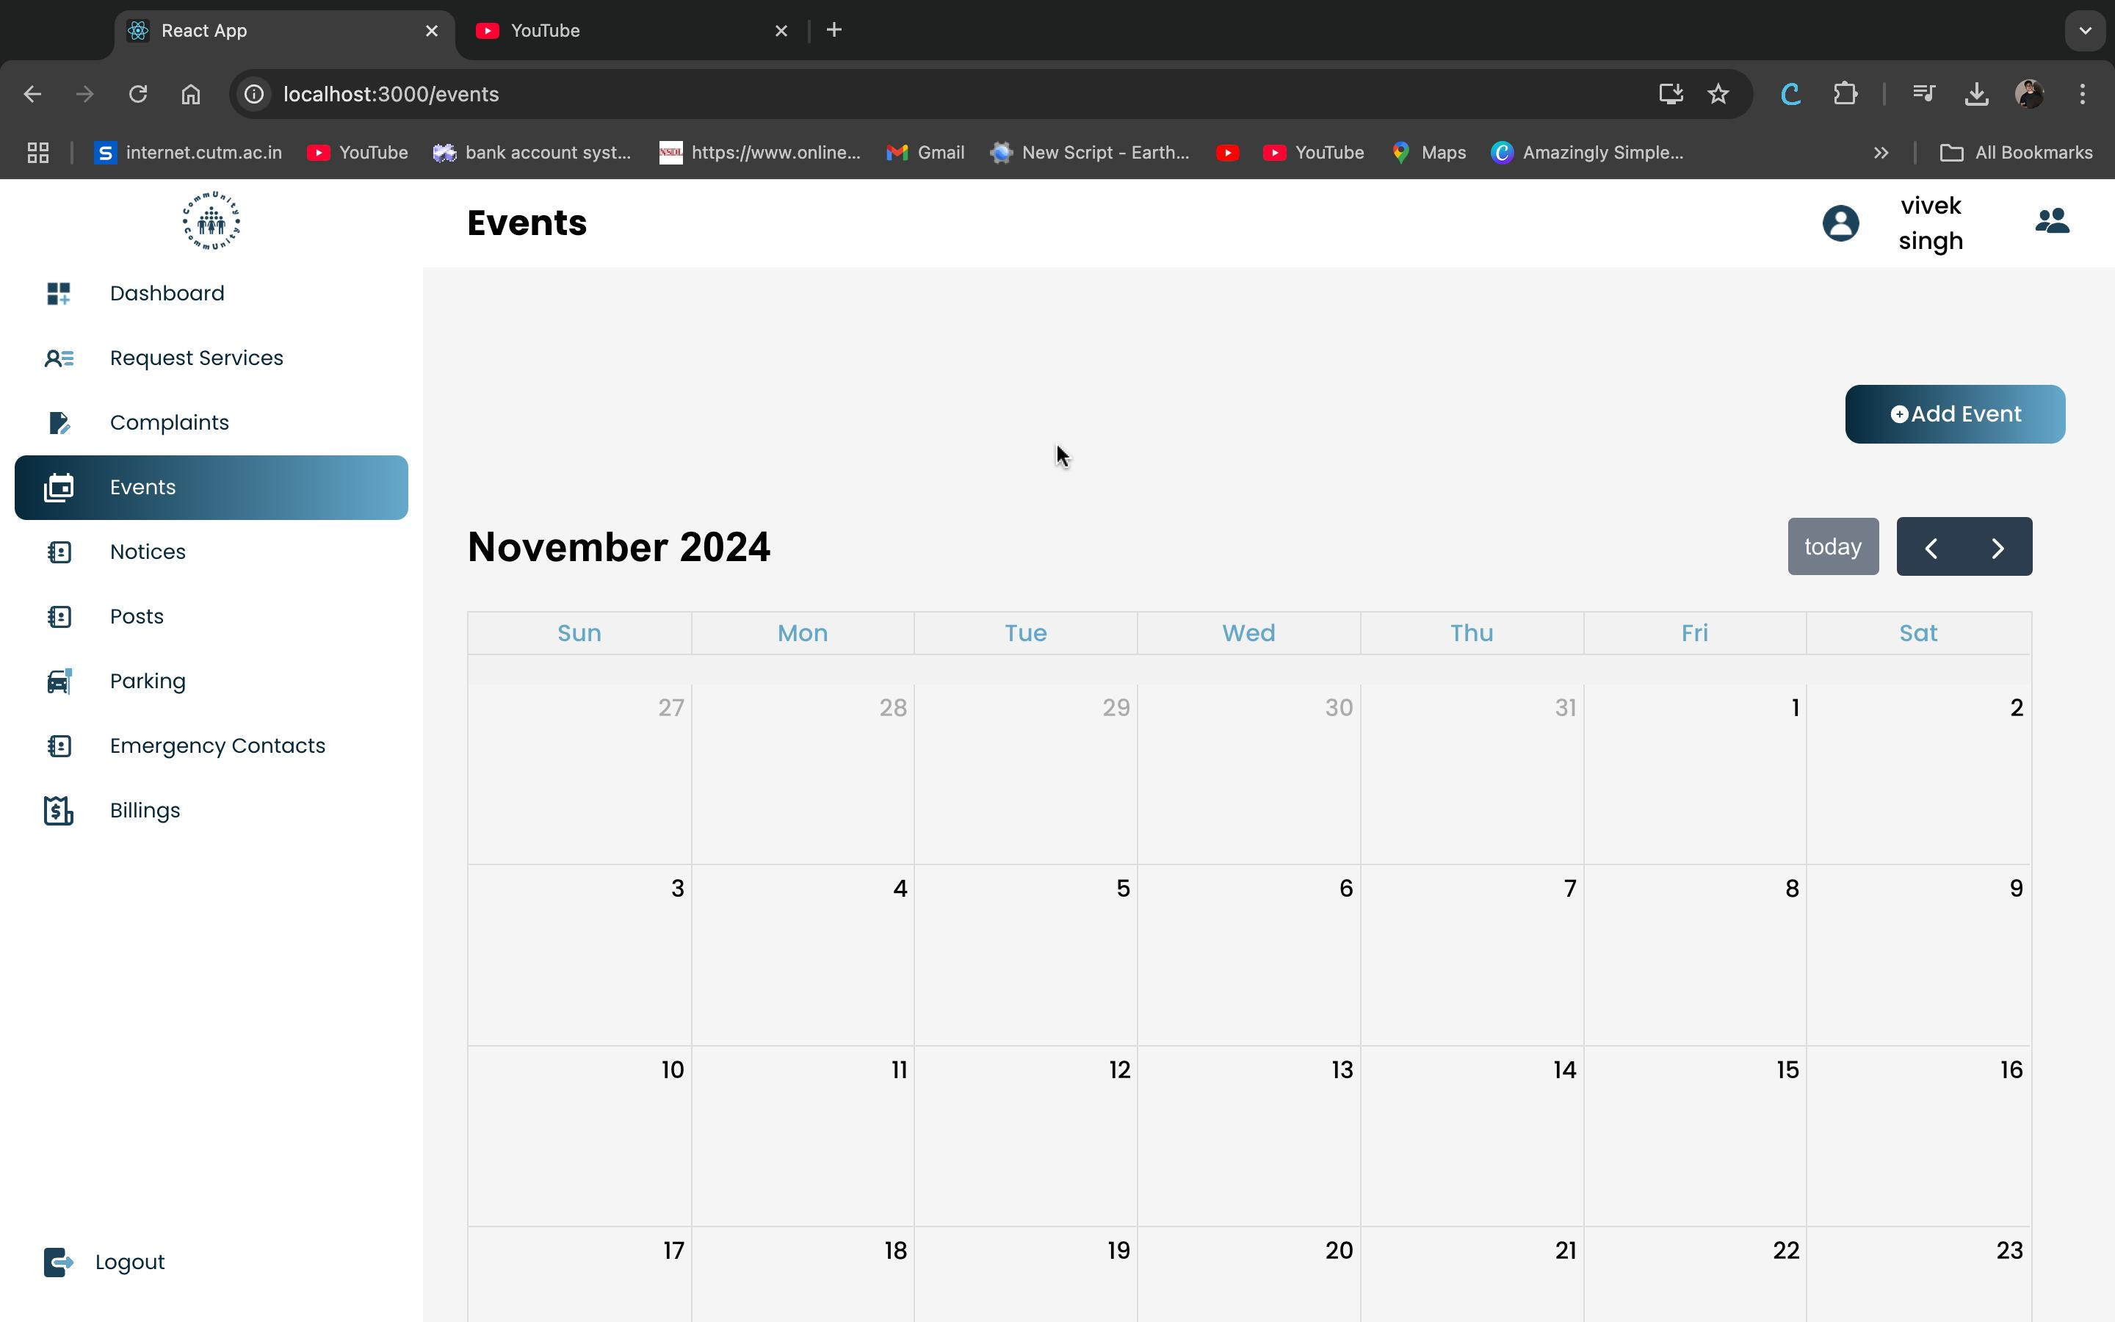

Slide 13
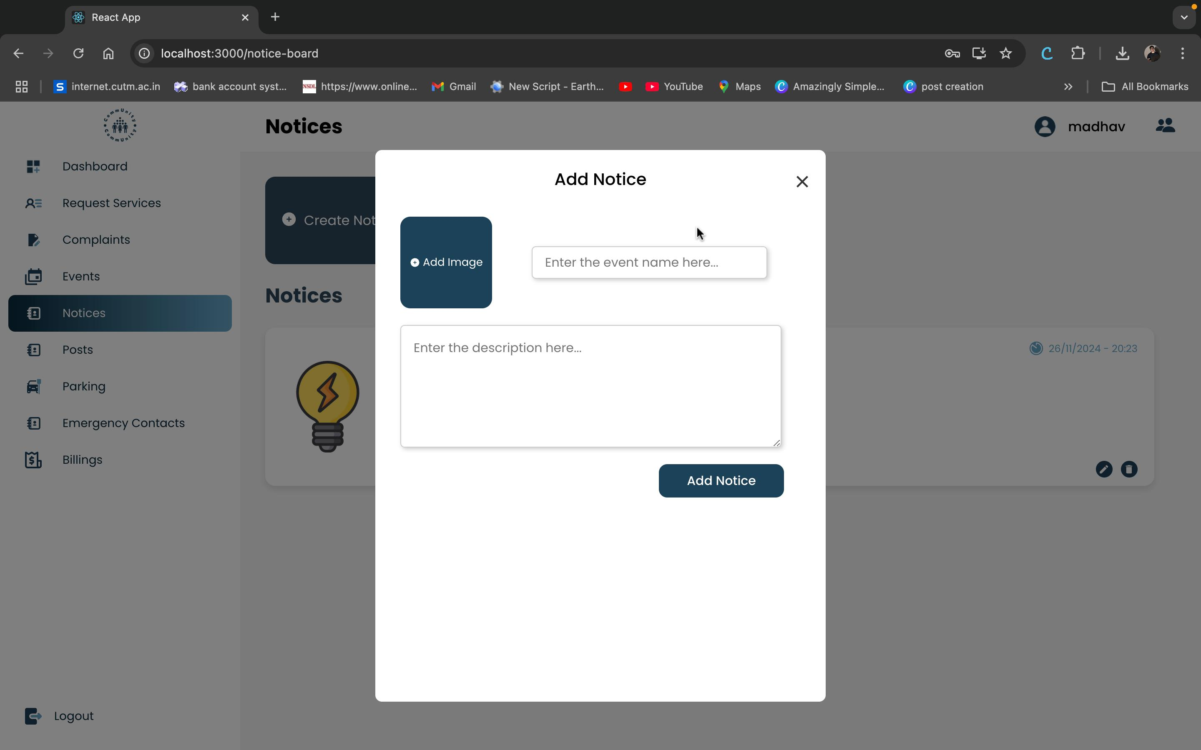

Slide 14
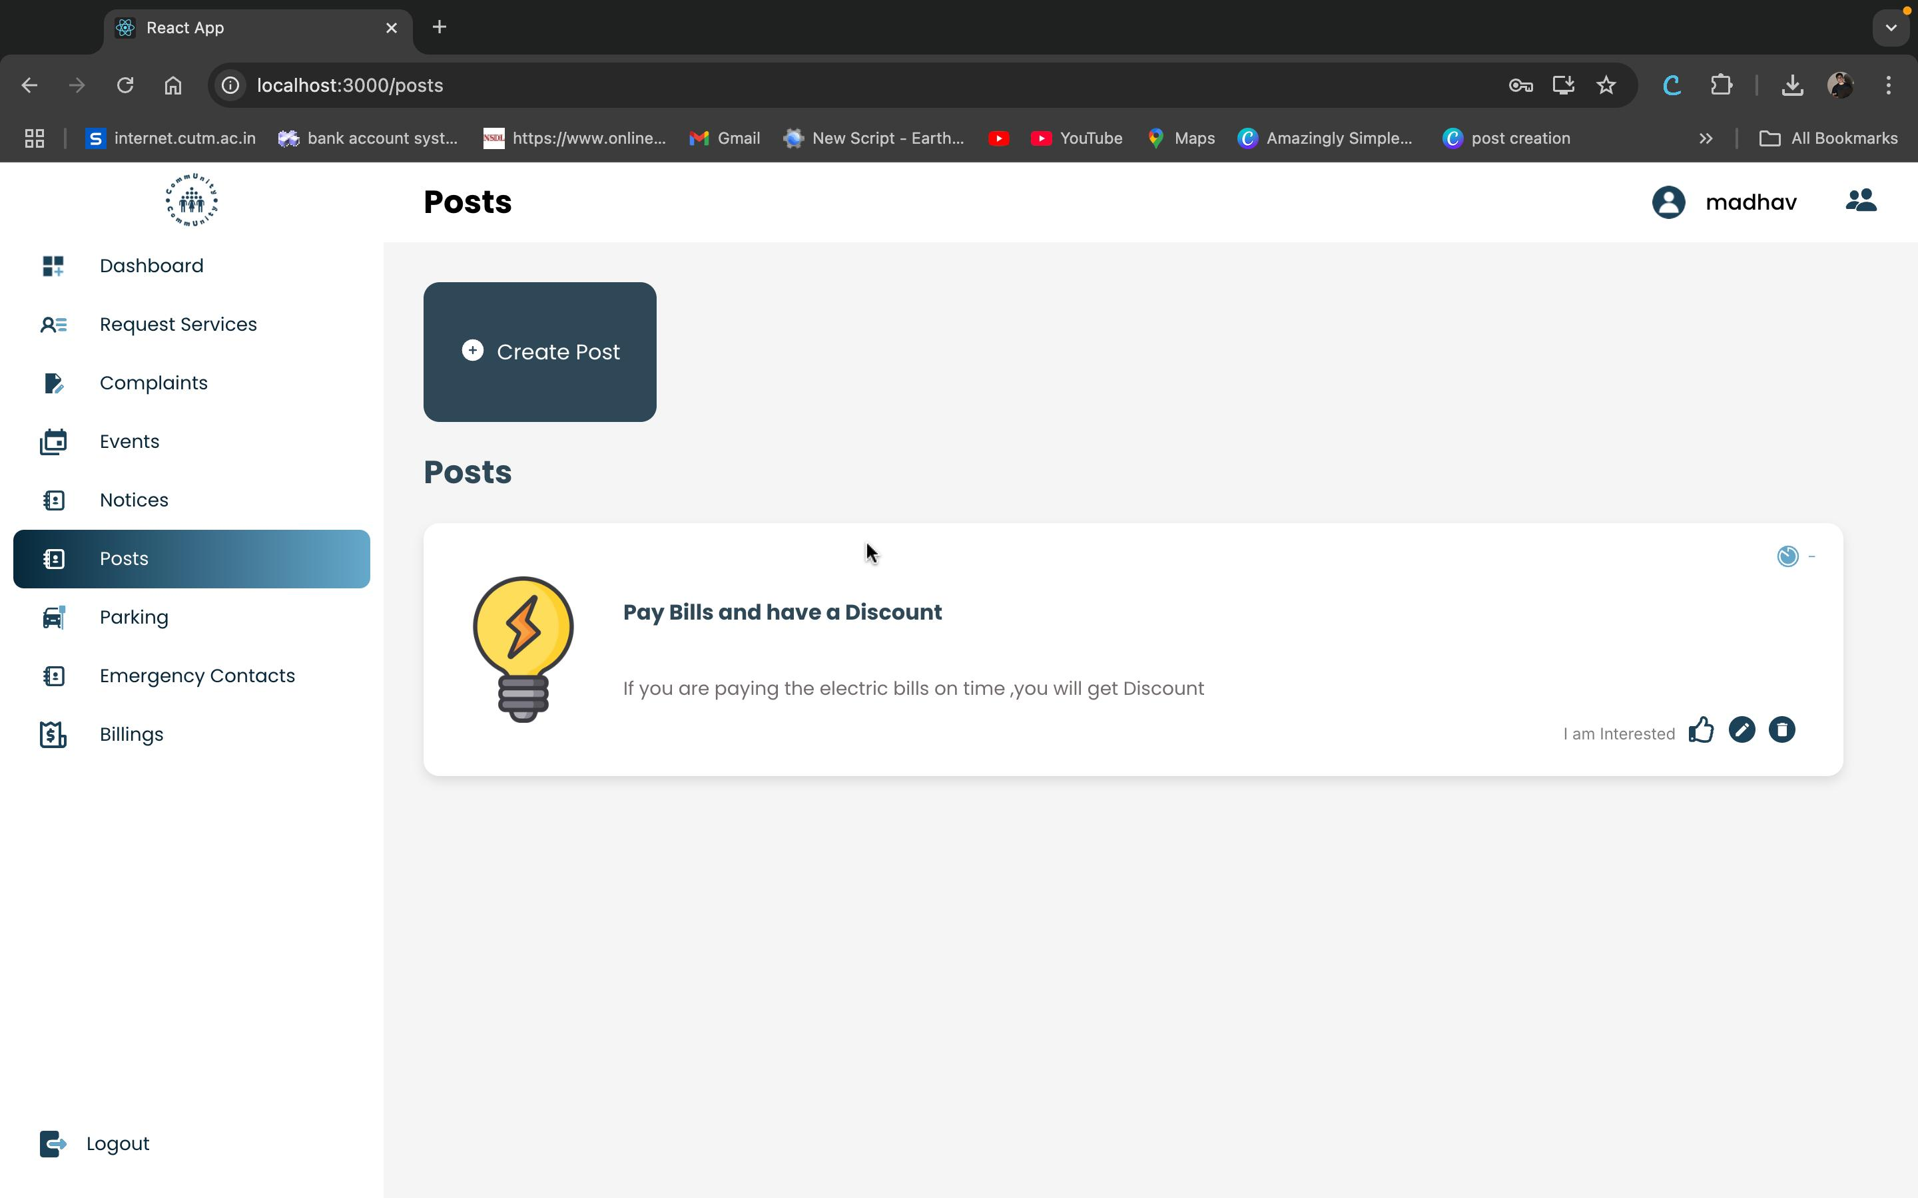

Slide 15
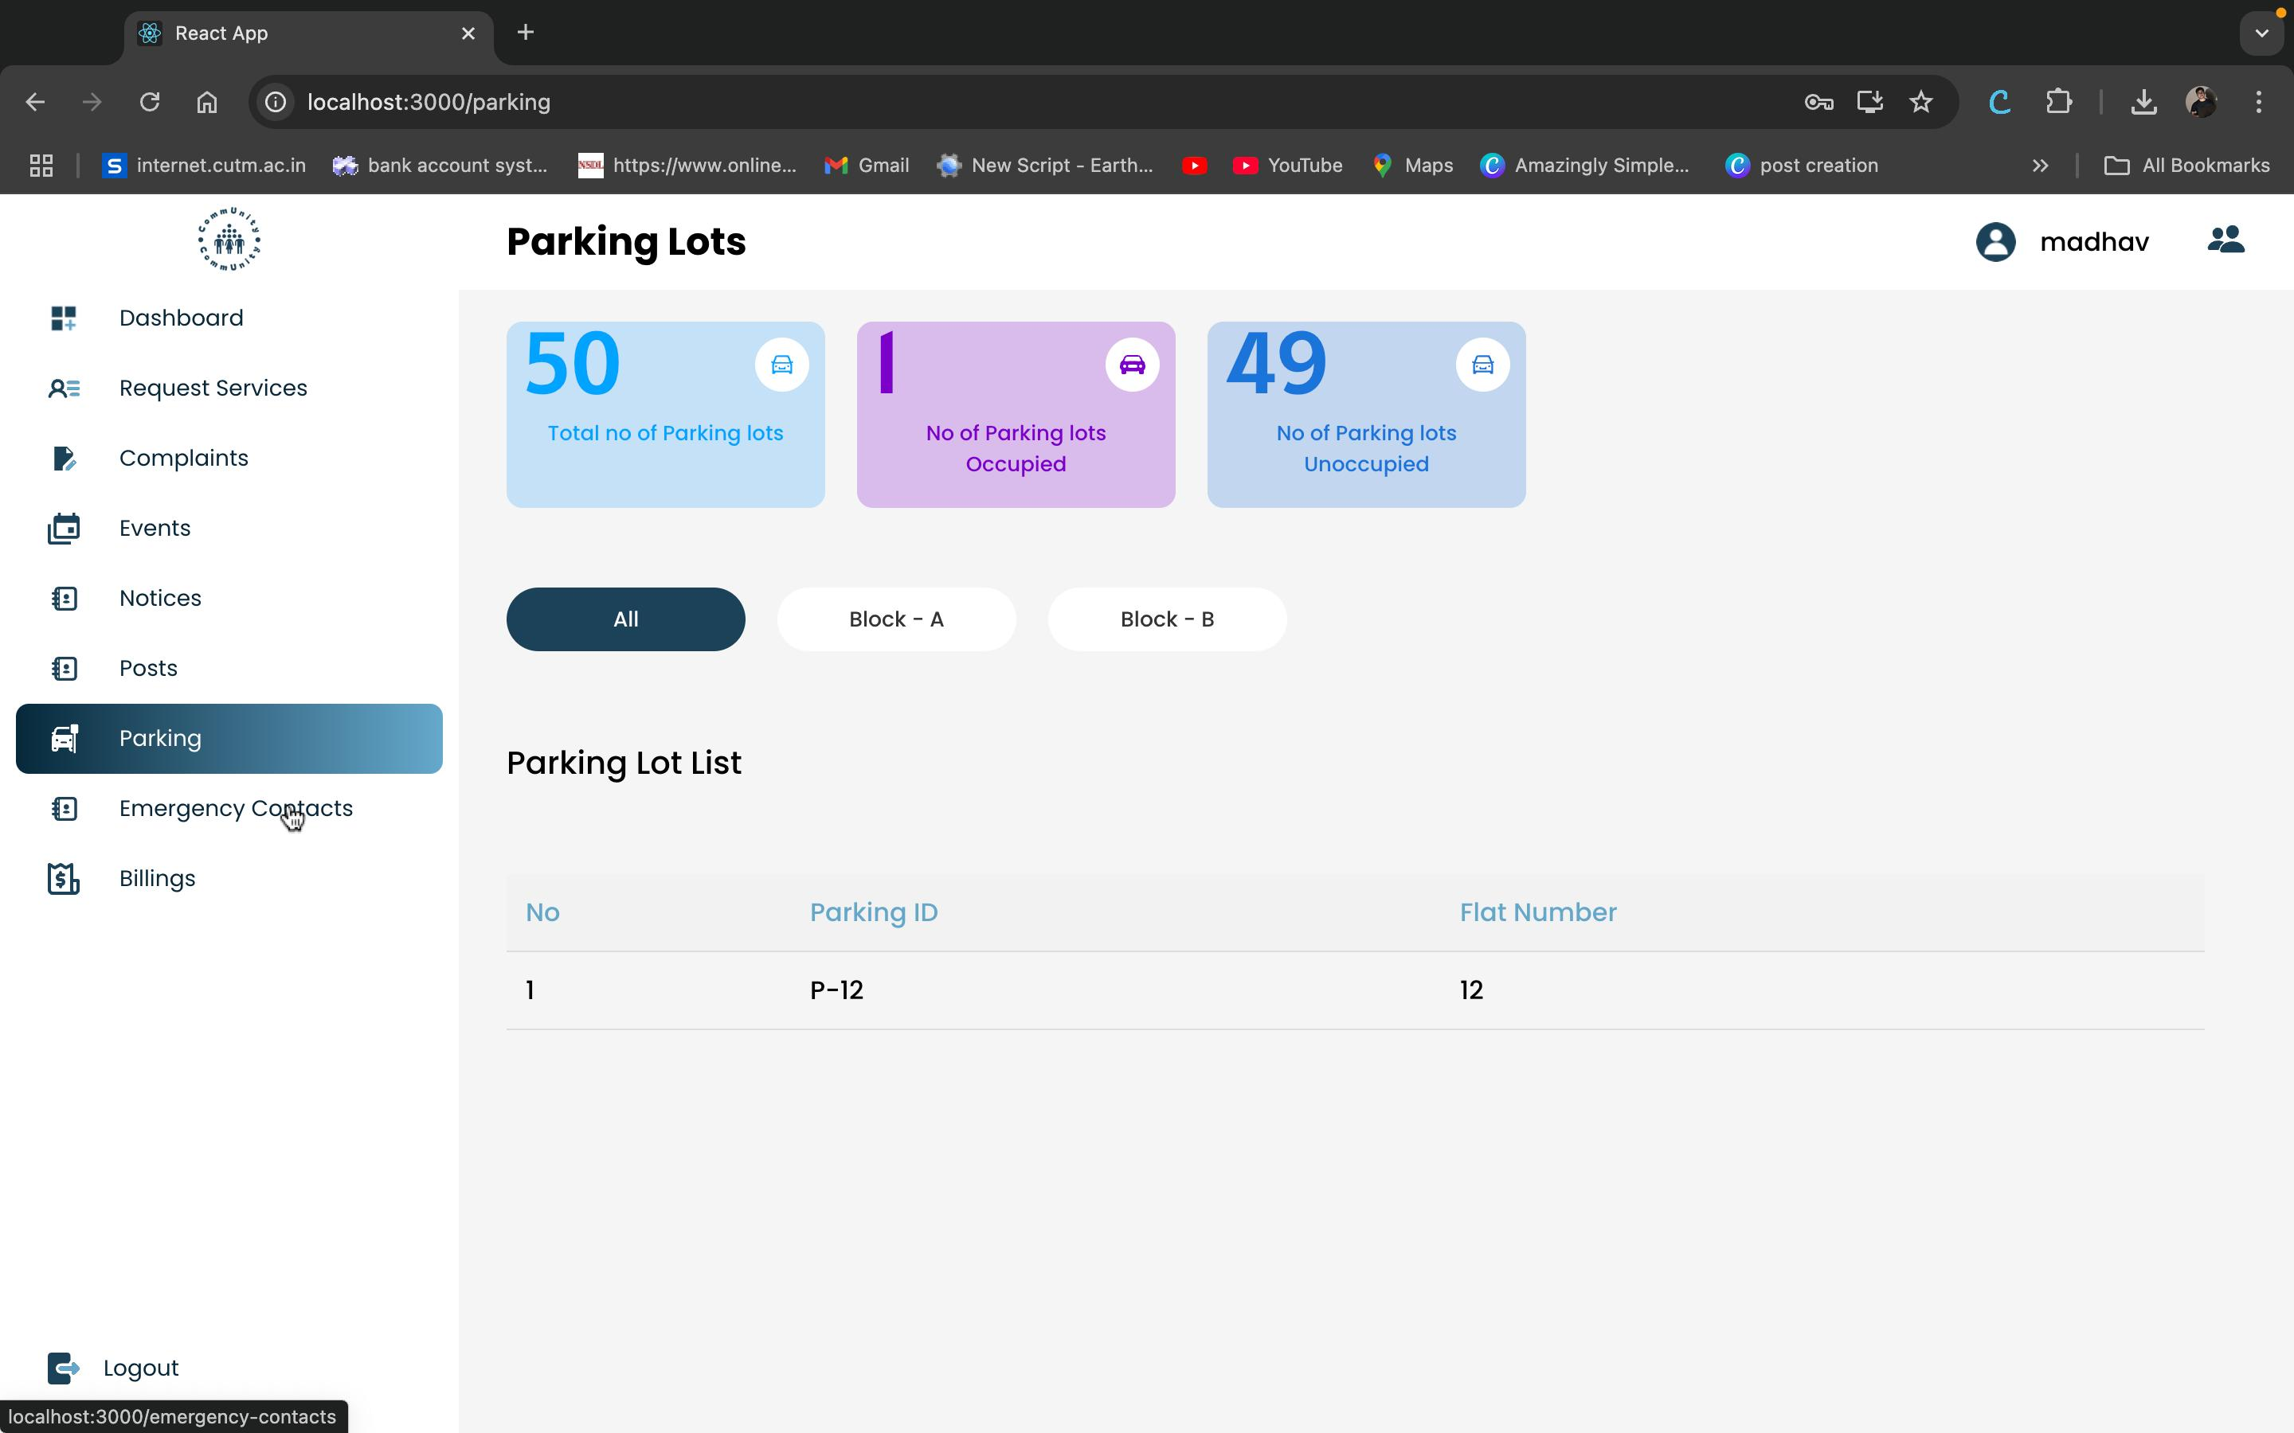

Slide 16
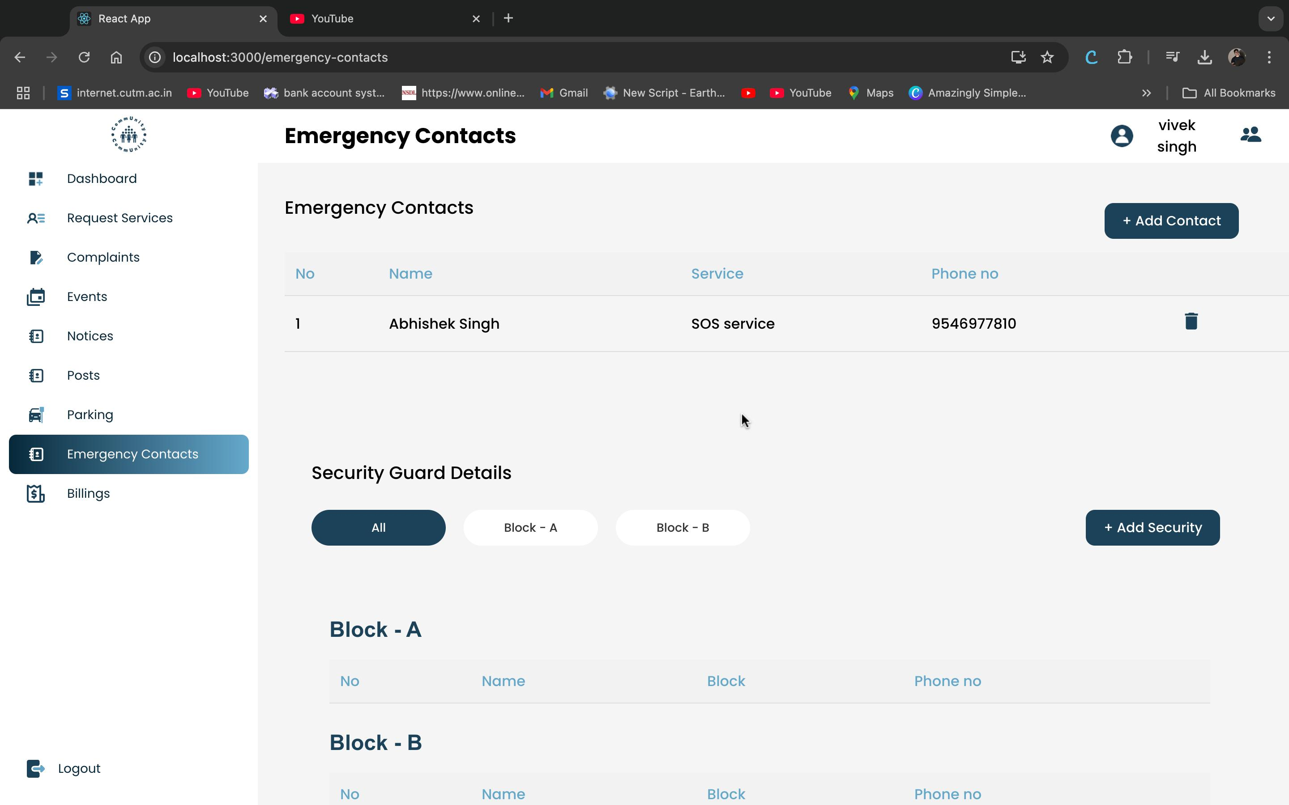

Slide 17
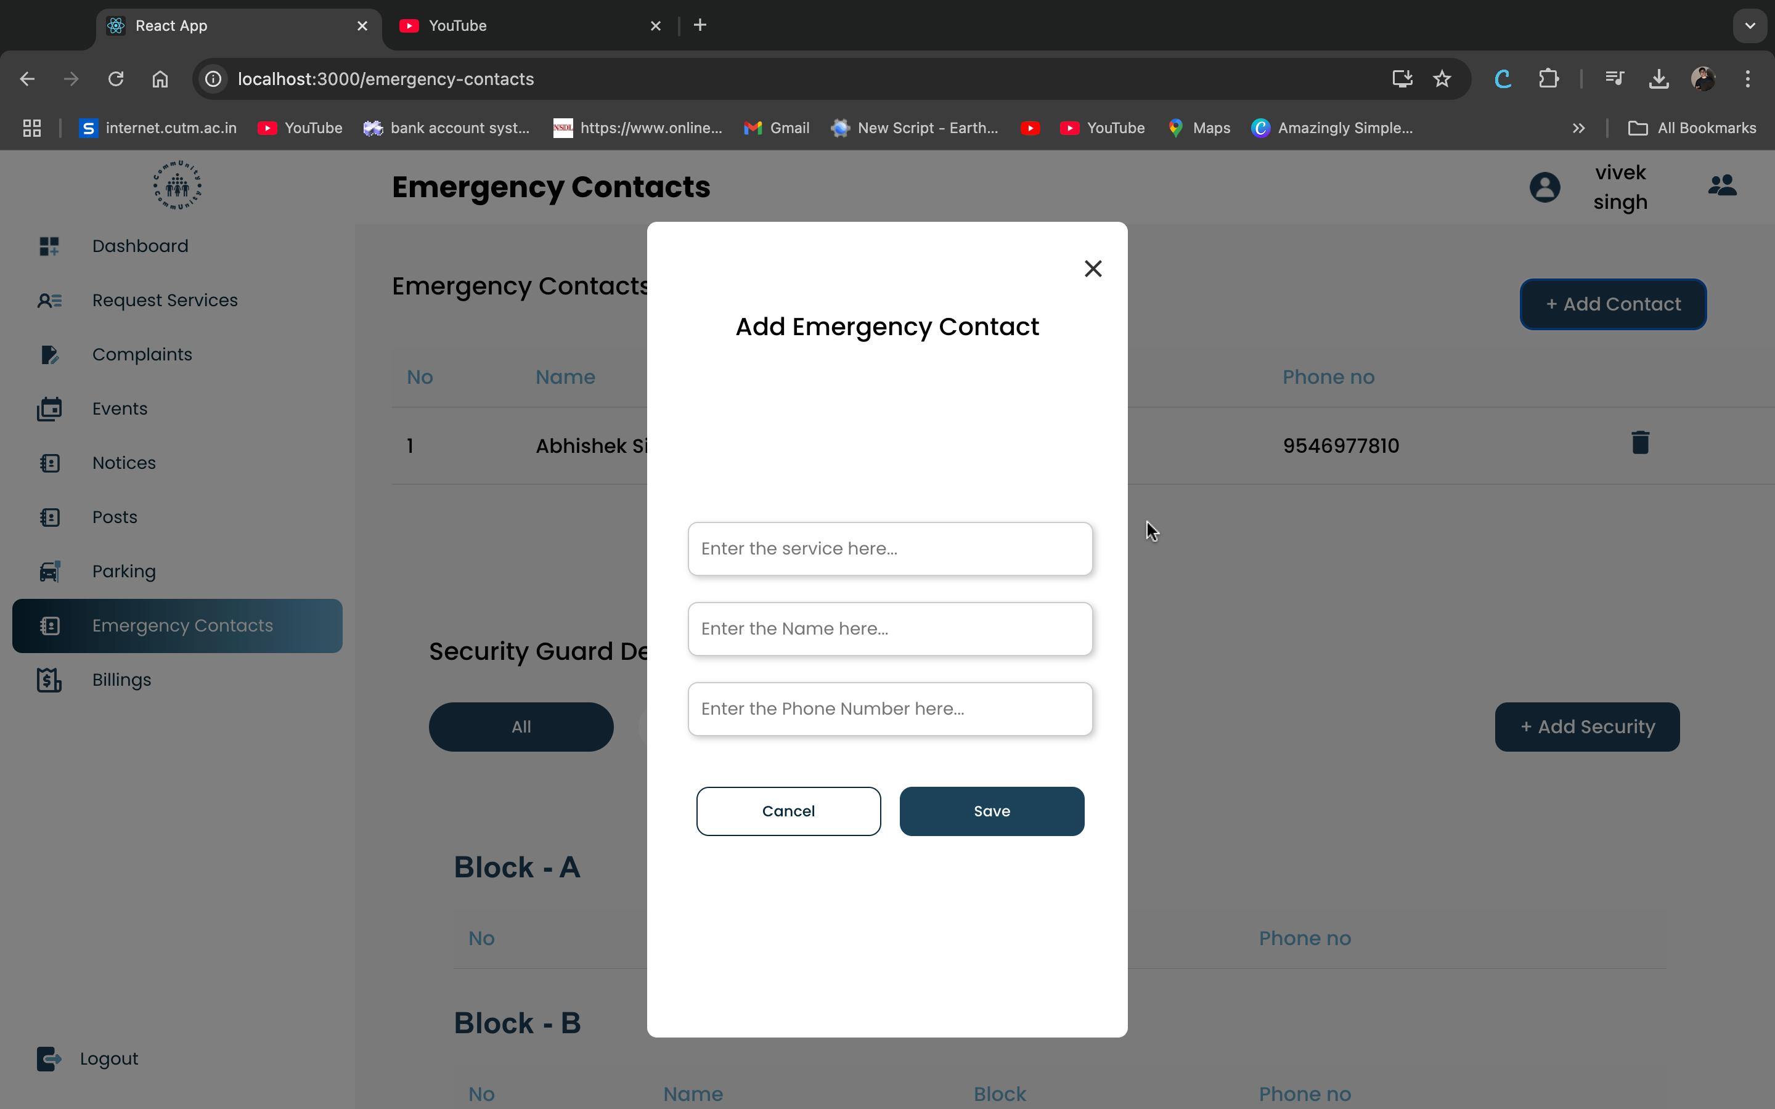

Slide 18
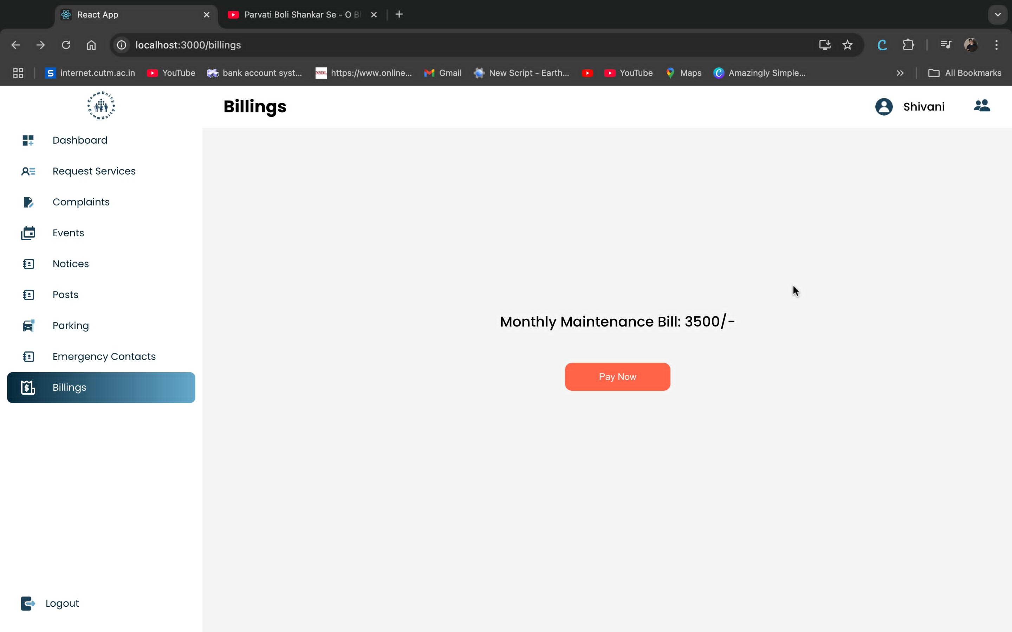

Slide 19
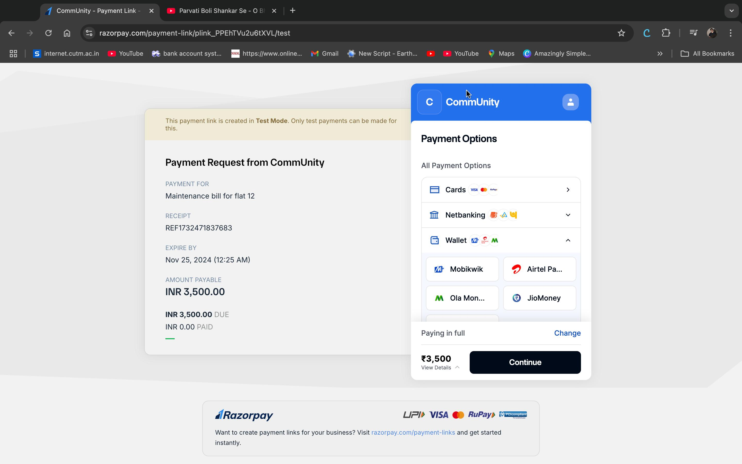

Slide 20
Tech Stack Used
Frontend: HTML, CSS, React, js
Backend: springboot,java
Database: MySQL
Integration: Razorpay API for payment processing.
Api testing tool: Postman (to test and validate API functionality).
IDE Tool: Visual studio code , IntelliJ IDEA

Slide 21



Slide 22


